Slide 1
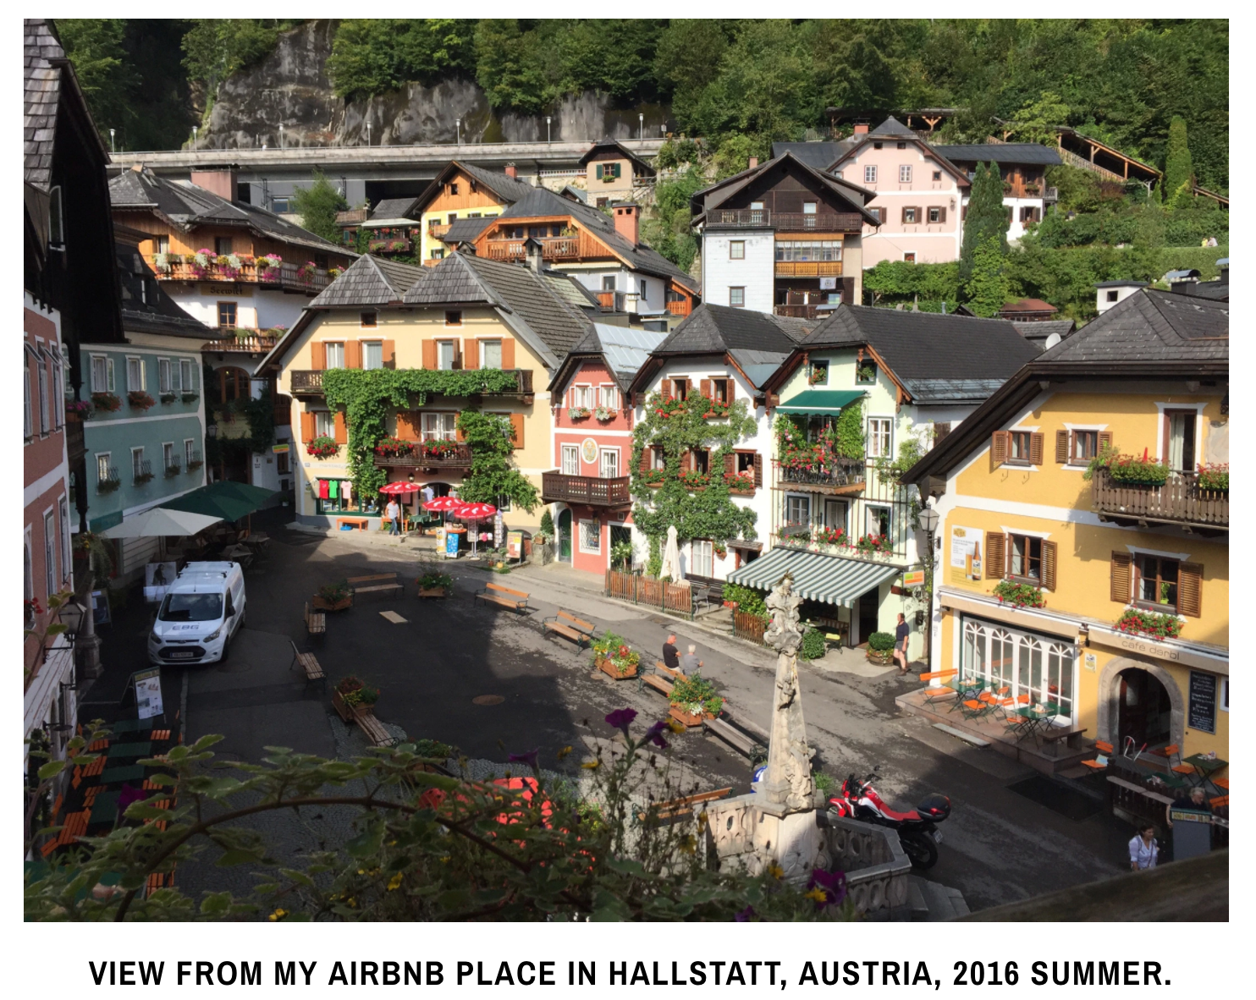
Airbnb Yield Prediction
Chao Li
PhD Candidate at NYU Chemistry

Slide 2
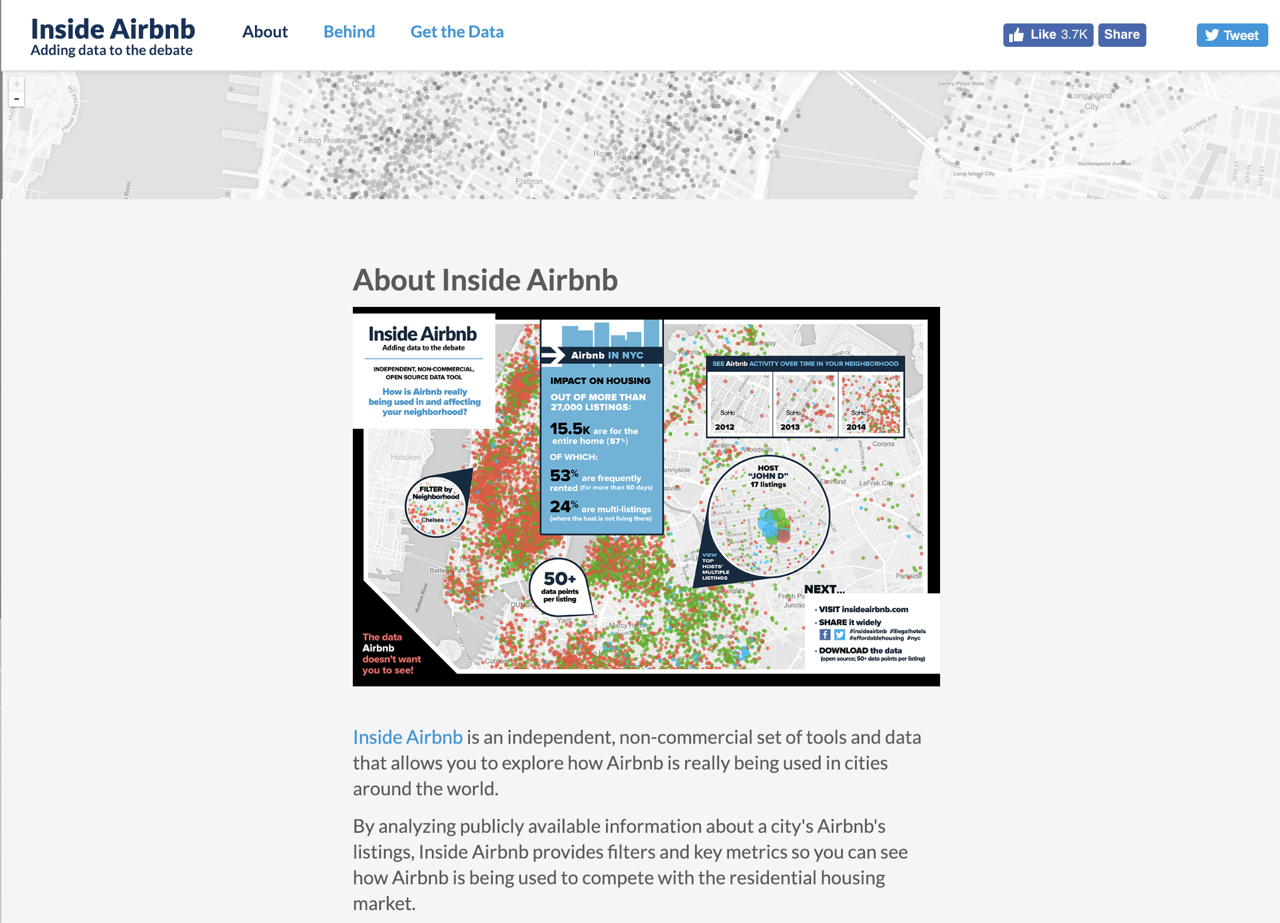
Where to get data?
Exploratory data analysis
Data cleaning
Web scraping photos
Photo quality assessment (both technically and aesthetically)
Text mining on description
Build machine learning models
Fine tuning the model
http://insideairbnb.com/get-the-data.html

Slide 3
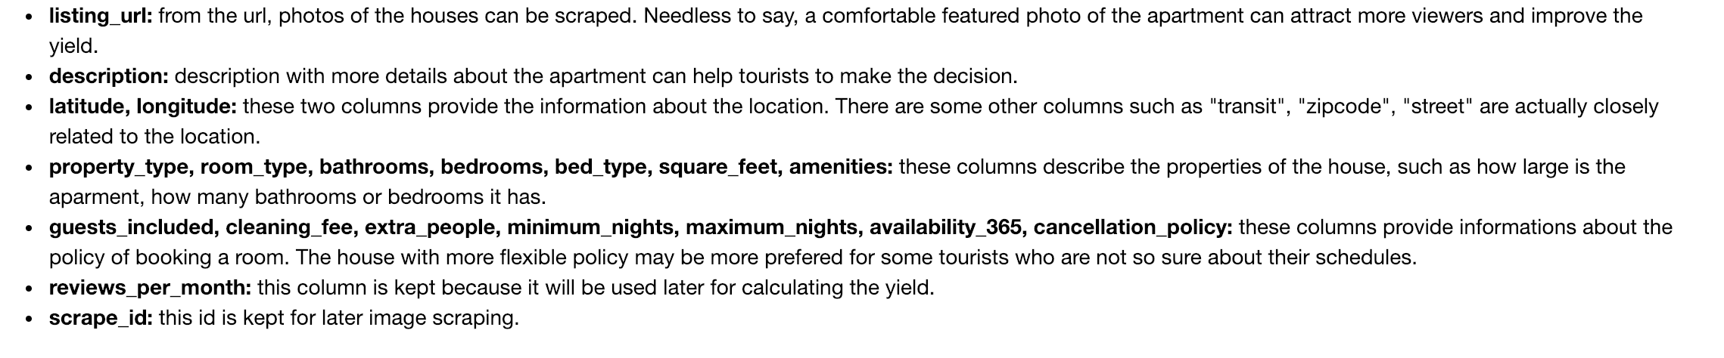
Preprocessing the data

Slide 4
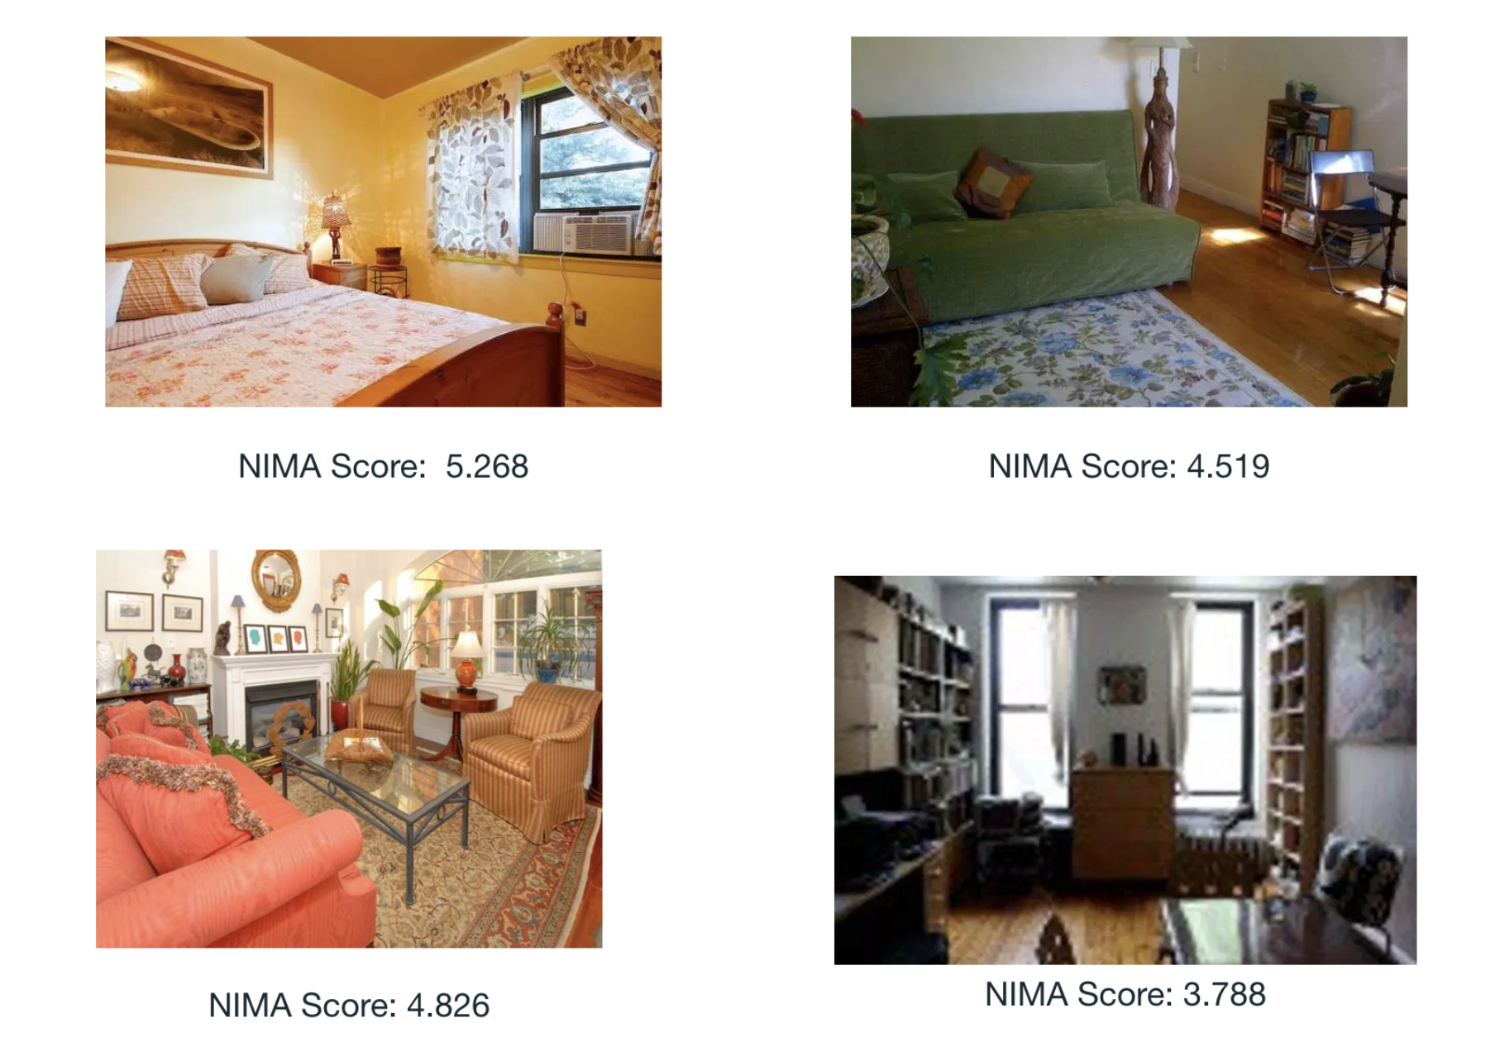
Neural Image Assessment on Photos of the listings

Slide 5
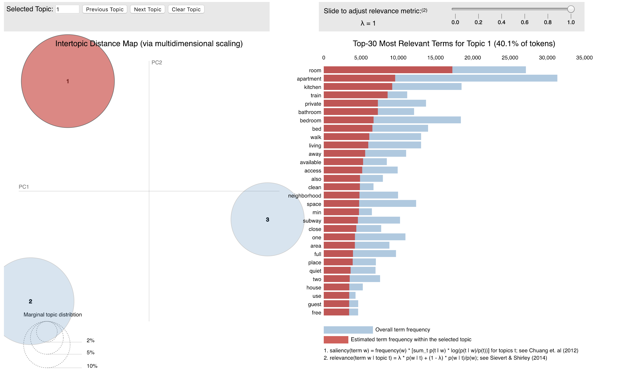
Sentiment Analysis on Description of the listings

Slide 6
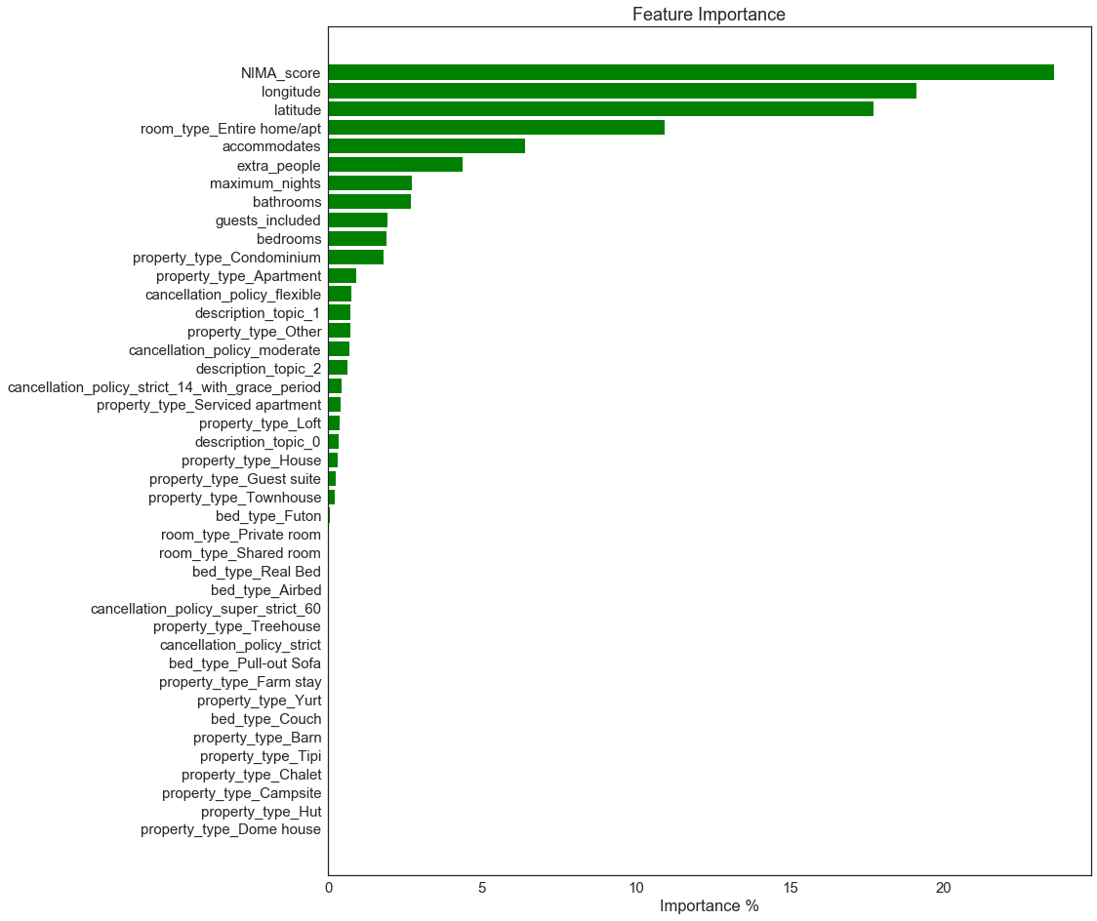
Feature Importance

Slide 7
Summary
The goal for this project is to build machine learning models to give potential hosts some insights on how much they can earn from listing their beloved houses on Airbnb.
There are definitely lots of information can be obtained from web photos and descriptions. My preliminary data shows that incorporating these informations into machine learning model can improve the performance.

